Slide 1

Introduction à Xamarin.Forms
Roger Leblanc
Programmeur-analyste chez Micromedica
github.com/RodgerLeblanc
roger@rogerleblanc.net

Slide 2
C'est quoi Xamarin?
Notes:
So, let’s start with exactly what Xamarin is.

Slide 3
Une structure open source par
Microsoft pour concevoir des applications
iOS, Android, & Windows avec .NET
en utilisant un seul code partagé.

Slide 4

.NET
C#
C#
C#
C# Partagé
Logique Applicative
C# partagé • Accès à 100% des API natifs • Haute performance
Notes:
We will look more at Xamarin.Forms, but now we can see a full picture of what goes into our app.

Slide 5
Code Partagé
En moyenne
les développeurs Xamarin
ont 80% de code partagé
entre leurs applications mobiles.
Notes:
Regardless of app approaches and if you need to mix in native APIs or UI in addition to Xamarin.Essentials and Xamarin.Forms, the average app shares nearly 80% of code.

Slide 6
Windows APIs
Windows.Media
Windows.Networking
Windows.Storage
Windows.Foundation
Windows.Devices
System.Net
System
System.IO
System.Linq
System.Xml
System.Data
System.Windows
System.Numerics
System.Core
System.ServiceModel
C#
Notes:
With .NET and Window development we always had the .NET Framework which offers tons of APIs for developers to use. When you want to target desktop or web, you download a SDK and get platform APIs.
© Microsoft Corporation. All rights reserved. MICROSOFT MAKES NO WARRANTIES, EXPRESS, IMPLIED OR STATUTORY, AS TO THE INFORMATION IN THIS PRESENTATION.
20-1-29 22:23:00

Slide 7
Xamarin.iOS
MapKit
UIKit
SiriKit
ARKit
CoreML
System.Net
System
System.IO
System.Linq
System.Xml
System.Data
System.Windows
System.Numerics
System.Core
System.ServiceModel
C#
Notes:
What the Xamarin platform does for iOS, Android, macOS, watchOS, and tvOS is bring .NET directly to them and the platform delivers “C# bindings” around the native APIs. So you have access to everything, directly in C#.
Here we see just a few of the thousands of APIs available for iOS
Build 2015
© 2015 Microsoft Corporation. All rights reserved. MICROSOFT MAKES NO WARRANTIES, EXPRESS, IMPLIED OR STATUTORY, AS TO THE INFORMATION IN THIS PRESENTATION.
20-1-29 22:23:00

Slide 8
Xamarin.Android
Fingerprint
Bluetooth
Picture-in-Picture
Geolocation
NFC
System.Net
System
System.IO
System.Linq
System.Xml
System.Data
System.Windows
System.Numerics
System.Core
System.ServiceModel
C#
Notes:
The same is true for Android with thousands of APIs beyond these. In addition, the Xamarin platform delivers essential integrations which we will talk about such as Google Play services and the support libraries.
Build 2015
© 2015 Microsoft Corporation. All rights reserved. MICROSOFT MAKES NO WARRANTIES, EXPRESS, IMPLIED OR STATUTORY, AS TO THE INFORMATION IN THIS PRESENTATION.
20-1-29 22:23:00

Slide 9













Accès Aux API Natifs
Notes:
The first part in the head projects is access to any of the unique APIs in iOS and Android. You have access to them all in C#. Now, these do have to be written in the head project and aren’t shared since they are unique to each platform. However, the Xamarin team has a way to help us out there.

Slide 10

Performance native
ARM BINARY
IL
+
JIT
.NET
.NET
.NET
AOT
.APP
Compile and Link
.APK
C#
C#
C#
Runs natively
Runs natively
Bindings
Bindings
Bindings
Xamarin.iOS utilise la compilation Ahead Of Time (AOT) afin de produire un binaire ARM pour le App Store d'Apple.
Xamarin.Android prend avantage de la compilation Just In Time (JIT) des appareils Android.
Notes:
In addition, Xamarin apps fully compile down into native binaries for each platform.

Slide 11
✓ Toujours à jour
Support au jour J:
iOS 5
iOS 6
iOS 7
iOS 8
iOS 9
iOS 10
iOS 11
iOS 12
iOS 13
Support pour:
iOS Extensions
Apple Watch
Apple TV
Android Wear
Amazon Fire TV
et plus
Notes:
To top it all off, Xamarin is on top of all the latest OS updates and additional platforms.

Slide 12
Xamarin.Forms
Notes:
Alright, we have gone through .NET, the Ecosystem, and where Azure can help out, but let’s look more in-depth at Xamarin.Forms.

Slide 13
.NET
✓ 40+ Pages, layouts, and controls
(Build from C# or XAML)
✓ Two-way data binding
✓ Navigation
✓ Visual State Manager
✓ Animation API
✓ Dependency Service
✓ Messaging Center
C#
C#
C#
UI Partagé
C# Partagé
Logique Applicative
Notes:
Xamarin.Forms is not just a UI library, it also contains full navigation, MVVM framework, Visual State Manager, Animation API, dependency services, and even a messaging center.

Slide 14
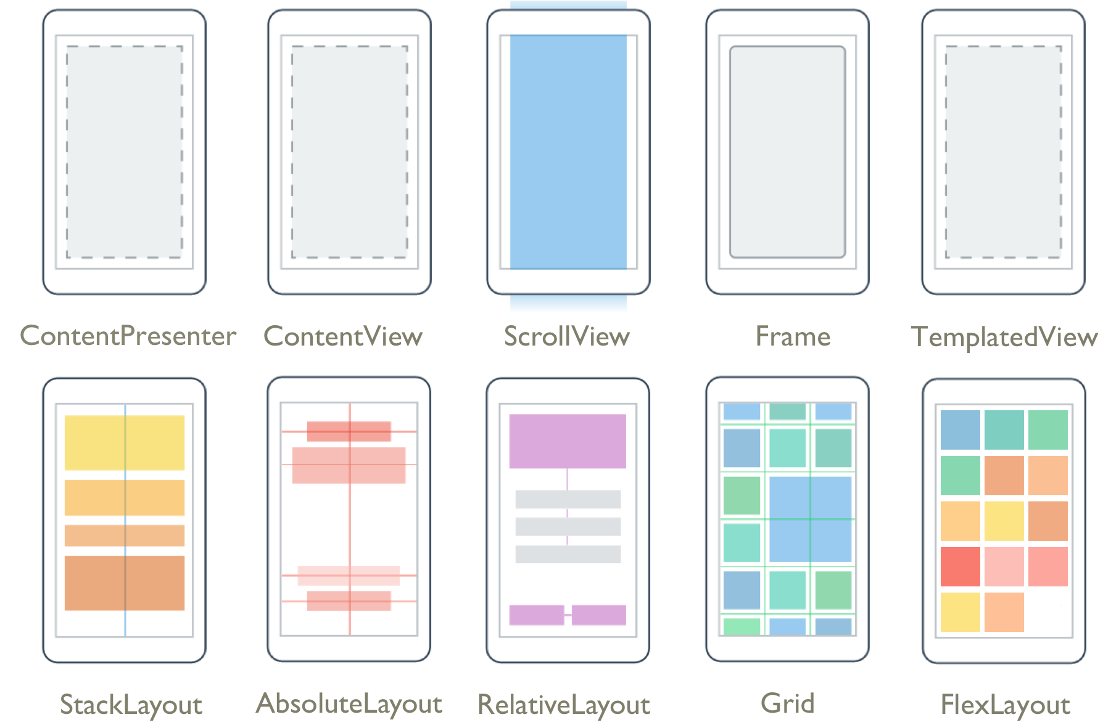
Pages & Layouts
Notes:
At the core are Pages and layouts of how you build your app. From a simple Stacklayout to Grids and even complex layouts with Flex to make really unique layouts that change with the orientation and device sizes.

Slide 15
Controls
ActivityIndicator
BoxView
Button
DatePicker
Editor
Entry
Image
Label
ListView
Map
OpenGLView
Picker
ProgressBar
SearchBar
Slider
Stepper
TableView
TimePicker
WebView
EntryCell
ImageCell
SwitchCell
TextCell
ViewCell
ImageButton
CarouselView
CollectionView
Notes:
Then there is the growing list of controls that you can use in your app. Each have several properties and events that you can optimize for your app.

Slide 16

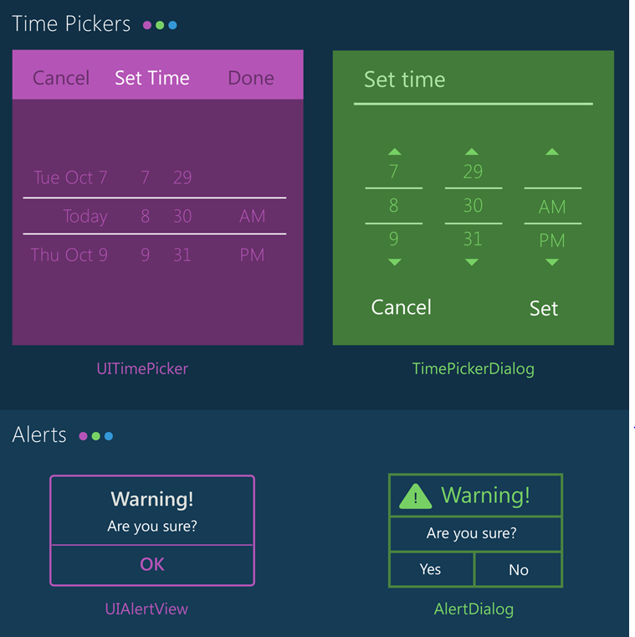
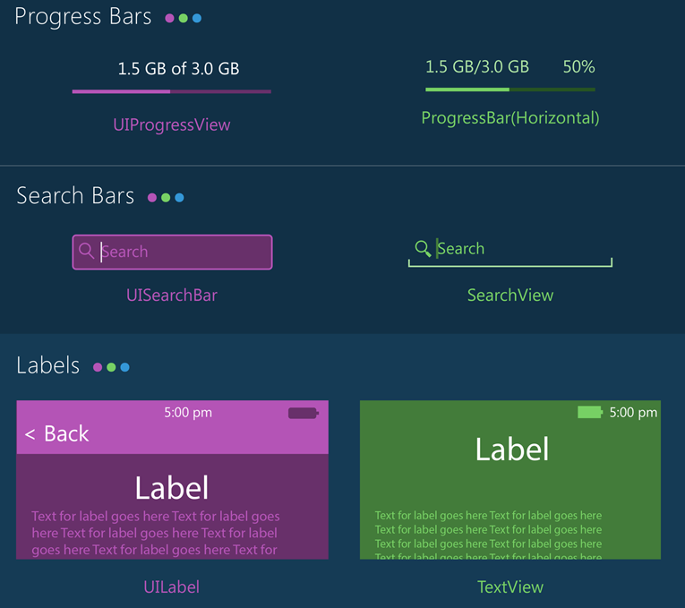
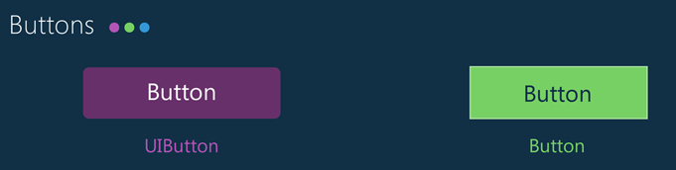
Notes:
With Xamarin.Forms you get the native controls on each platform so you app looks and feels native to the platform. However, with Xamarin.Forms and the new Visual API you can bring together your apps with a more similar material design look and feel.

Slide 17

Xamarin.Forms
Notes:
What about the user interface? Just like APIs you can build the native UI for each platform. However, many developers choose to share all or most of the UI with Xamarin.Forms

Slide 18

Xamarin.Essentials
Secure Settings
Sms
Preferences
Flashlight
Clipboard
Gyroscope
Magnetometer
Geolocation
Phone Dialer
Device Display Info
Email
Device Info
Battery
Compass
Accelerometer
Screen Lock
Data Transfer
Text to Speech
Geocoding
File System
Connectivity
Vibration
aka.ms/xamarinessentials
Notes:
Which is Xamarin.Essentials. An open source library that abstracts common native features into a single cross platform API for iOS, Android, and Windows. These are APIs that exist across each platform so why not bring them together.
Microsoft Build 2017
© Microsoft Corporation. All rights reserved. MICROSOFT MAKES NO WARRANTIES, EXPRESS, IMPLIED OR STATUTORY, AS TO THE INFORMATION IN THIS PRESENTATION.
20-1-29 22:23:00

Slide 19
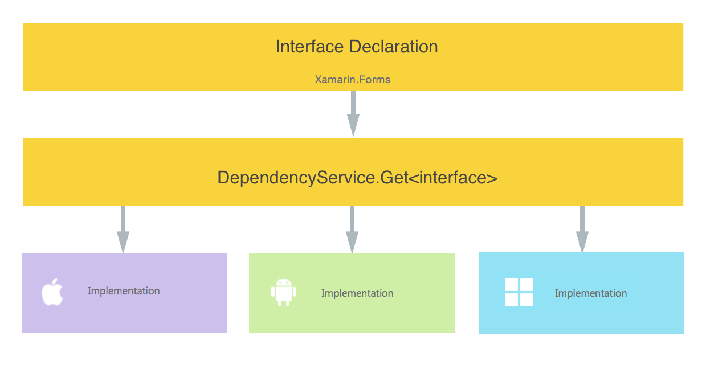
Dependency Service
Accès Facile Aux Fonctionnalités Natives
Notes:
And a dependency service for interface based programming and to get into platform implementations.

Slide 20

Intégrations
Notes:
There is a lot more to Xamarin and .NET as there is a wonderful ecosystem that has built up around it over the years.

Slide 21












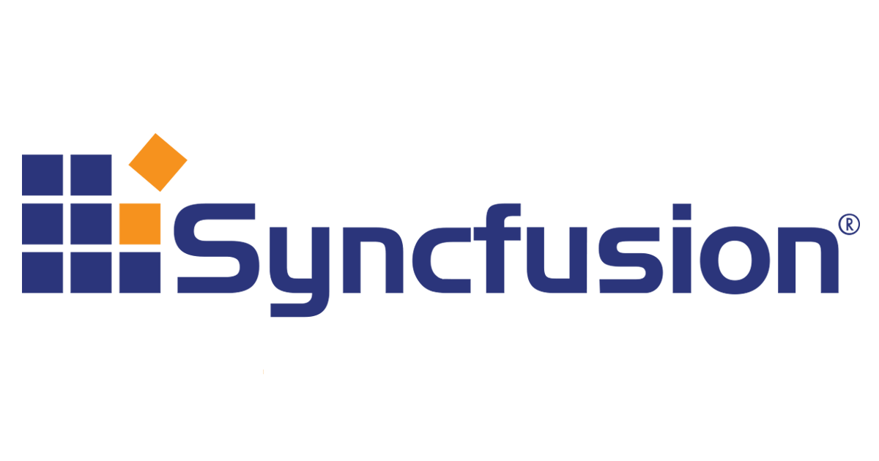

Librairies & Outils
Cognitive
Services
Azure Active
Directory B2C
Zxing
Barcode
Scanning
Akavache
Gorilla
Player
Zeplin
Notes:
First is libraries, essentially giving you anything that you need.

Slide 22
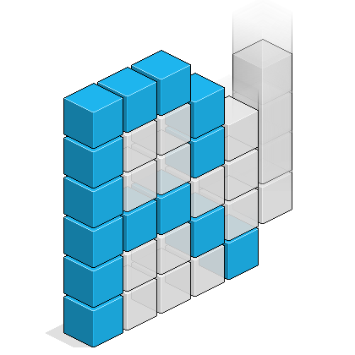




Frameworks
MVVMCross
Uno
ReactiveUI
Reactive Extensions
Notes:
There have even been specific frameworks for architecture and UI that have become industry standards.

Slide 23


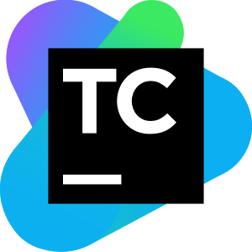



Continuous Integration & Delivery
Azure
Devops
Team
City
App
Center
Jenkins
Notes:
Not only does Xamarin work great with DevOps tools from Microsoft, but any CI and CD system out there.

Slide 24






Intelligent Clouds
IBM
MobileFirst
Firebase
Google
Cloud
Platform
Realm
Notes:
If you need a backend, Xamarin is open and you can use anything you desire.

Slide 25

Notes:
Now, let’s look deeper at what tools are built into Visual Studio for Xamarin developers.

Slide 26
Merci.
Roger Leblanc
Programmeur-analyste chez Micromedica
roger@rogerleblanc.net
github.com/RodgerLeblanc
Notes:
© 2014 Microsoft Corporation. All rights reserved. Microsoft, Windows, and other product names are or may be registered trademarks and/or trademarks in the U.S. and/or other countries. The information herein is for informational purposes only and represents the current view of Microsoft Corporation as of the date of this presentation. Because Microsoft must respond to changing market conditions, it should not be interpreted to be a commitment on the part of Microsoft, and Microsoft cannot guarantee the accuracy of any information provided after the date of this presentation. MICROSOFT MAKES NO WARRANTIES, EXPRESS, IMPLIED OR STATUTORY, AS TO THE INFORMATION IN THIS PRESENTATION.
20-1-29

Slide 27
bit.ly/atelierxamarin
Roger Leblanc
Programmeur-analyste chez Micromedica
roger@rogerleblanc.net
github.com/RodgerLeblanc
Notes:
© 2014 Microsoft Corporation. All rights reserved. Microsoft, Windows, and other product names are or may be registered trademarks and/or trademarks in the U.S. and/or other countries. The information herein is for informational purposes only and represents the current view of Microsoft Corporation as of the date of this presentation. Because Microsoft must respond to changing market conditions, it should not be interpreted to be a commitment on the part of Microsoft, and Microsoft cannot guarantee the accuracy of any information provided after the date of this presentation. MICROSOFT MAKES NO WARRANTIES, EXPRESS, IMPLIED OR STATUTORY, AS TO THE INFORMATION IN THIS PRESENTATION.
20-1-29

